Slide 1
Jharkhand
Mid Day Meal Scheme
Annual Work Plan and Budget
2018-19
Date : 25-05-2018

Slide 2
REVIEW OF IMPLEMENTATION OF Mid Day Meal Scheme
in Jharkhand (Primary + Upper Primary) (1.4.2017 to 31.03.2018)
Ministry of HRD, Govt. of India

Slide 3
BEST PRACTICES
Rs. 500 additional payment of honorarium to Cook-cum helper from State own resources.
Every last Saturday of the month all Head Teachers of all schools from the Block level hold meeting under the Chairmanship of Block Education Extension Officer (BEEO) which is called Guru Gosthi.
One apple or banana/ boiled egg served to the children thrice a week (Monday, Wednesday and Friday) and Biscuits/Muri chana served on Tuesday and Thursday.
2oo ml fortified flavoured milk per child per day is provided for 10,000 children in 35 schools of Latehar District by National Dairy Development Board's (NDDB).
100% inspections of schools have been done by the officials of the State on quarterly basis.
100% cook-cum-helpers and Sanyojika of Sarswati Vahini Sanchalan Samitee (SVSS) have been trained by master trainer in 2017-18.

Slide 4
Issues
Less coverage of children against enrolment. 67% in Primary & 63% in Upper primary.
Less coverage of working days during the year 2017-18 (8 days in Primary, 7 days in Upper Primary.
As per FCI statement, outstanding bills of Rs. 39.97 crore is pending at State level upto 31.3.2018.
2533 Kitchen-cum-Stores not yet surrendered.
Slow progress for monthly data entry (88%).
Huge variation of data in MIS & AWP&B-2018-19 provided by State.
Only 34% schools on an average are able to report through Automated Monitoring System

Slide 5
Innovations etc.
It is proposed that the States and UTs may also be given flexibility to utilize, with prior approval of MHRD, 5% of their Annual Work Plan & Budget for new interventions provided they are not included under any of the Central or State Schemes and there is no overlapping of activities. This is subject to CCEA approval.
Some of the suggested innovation may be in the field of Water filters, kitchen gardens, provision of LPG connections, use of millets etc. These are only illustrative and not exhaustive.
Community participation.
Meetings of District committee headed by Dist. Collector.

Slide 6
Institutions : Existing vs Achievement (Primary)
No. of Institutions in thousand
99.5%
95.7%
100%
Ministry of HRD, Govt. of India

Slide 7
Institutions : Existing Vs Achievement
(Upper Primary)
No. of Institutions in thousand
100%
100%
100%
Ministry of HRD, Govt. of India

Slide 8
Children : Enrolment Vs Coverage (Primary)
(Fig. in Lakh)
57%
61%
67%

Slide 9
Children : Enrolment Vs Coverage
(Upper Primary)
(Fig. in Lakh)
54%
57%
63%

Slide 10
Private Schools (Primary & Upper Primary)
Enrolment
Schools
(Fig. in Lakh)

Slide 11
Aadhaar Enrolment
(Fig. in Lakh)

Slide 12
Working days coverage

Slide 13
Food grain: allocation vs utilization (in MTs)
(MTs in Thousand)

Slide 14
Payment of cost of food grains to FCI
As per FCI statement as on 31-03-2018 total pending bills is Rs.39.96 Cr.
(Rs. in Lakh)

Slide 15
Cooking cost : Allocation vs utilization
(Rs. In Cr.)

Slide 16
Cook-cum-Helpers: Approval vs Engaged
(Fig. in Thousand)

Slide 17
MME: ALLOCATION vs UTILIZATION
(Rs. in Cr.)

Slide 18
Transportation Assistance : Allocation vs Utilization
(Rs. in Cr.)

Slide 19
Construction of Kitchen cum Stores
(%age)

Slide 20
Procurement of Kitchen Devices
(%age)

Slide 21
Coverage : RBSK
Details | Institutions | Children
Children covered | 33118 | 3826058 (82%)
Health Check up | 20873 | 1976948 (42%)
IFA Distribution | 19083 | 1395169 (30%)
Deworming Tablets | 25482 | 2552435 (55%)
Spectacles | 6322 | 31921

Slide 22
Elements of Ayushman Bharat
Electronic Health Records
Electronic health record for each child
Upgrading skills of emergency care
Training on basic first aid for the teachers
School Health Promotion Activities
Provision of Services
Health Screening
Age appropriate learning for promotion of healthy behavior and prevention of various diseases
Delivered through school teachers trained as Health Ambassadors in coordination with health department staff.
Screening of children 30 identified health conditions for early detection, free treatment and management through dedicated RBSK mobile health teams
Iron Folic Acid (IFA) tablets, Albendazole administration will be provided by teachers through WIFS and National Deworming Day (NDD) programme respectively.
Provision of Sanitary Napkins.
Identification of malnourished and anemic children and appropriate referrals to PHCs and hospitals. The periodicity of such checkups may be increased.
Age appropriate vaccination.
Availability of potable drinking water
Yoga and Meditation

Slide 23
Drinking water facilities
Total Schools | 39740
Schools having drinking water facilities | 39518 (99%)
Safe drinking water facilities | 39518 (99%)
Water filtration | 298 (1%)
RO/UF | 41
UV purification or e-boiling | 4
Candle filter purifier | 242 (1%)
Activated carbon filter purifier | 9

Slide 24
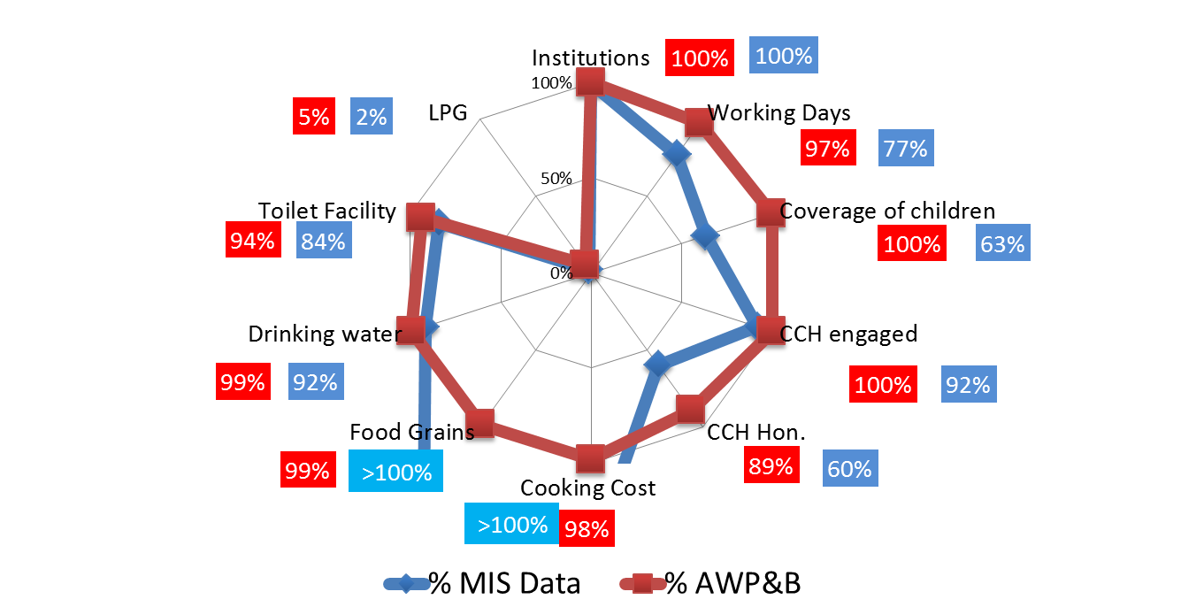
Comparison : AWP&B vs MIS Data

Slide 25
Automated Monitoring System (AMS)
(%age)

Slide 26
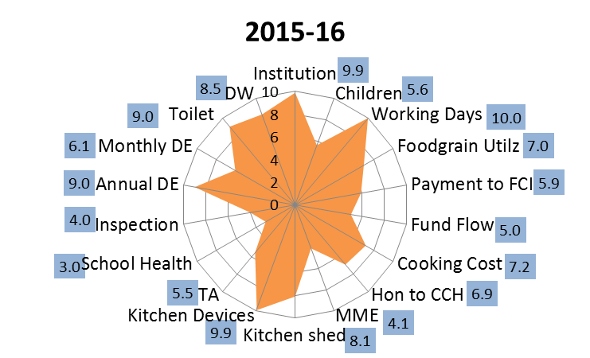
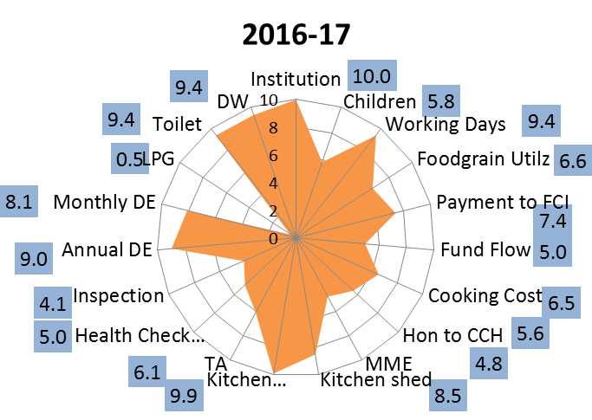
Over all Score Card for 3 Years :important Components

Slide 27
State’s Proposal for 2018-19

Slide 28
Proposal for 2018-19 : Children (Primary)
f
(Fig. in Lakh)
Q1
Q2
Q3
Q4

Slide 29
Proposal for 2018-19 : Children (U. Primary)
f
(Fig. in Lakh)
Q1
Q2
Q3
Q4

Slide 30
Proposals and Recommendations
S. | Component | PAB Approval 2017-18 | State’s Proposal for 2018-19 | Recommendation 2018-19
1 | Children (Pry) | 206379 | 2398065 | 2251113
2 | Children (U Pry) | 925473 | 1014800 | 954152
3 | NCLP | 7309 | 4649 | 4649
4 | Working Days – Pry & Upy | 254 | 254 | 254
5 | Working Days – NCLP | 311 | 312 | 312
6 | Cook cum Helper | 85066 | 81577 | 81577
7 | Drought - Children (Pry) | NA | NA | NA
8 | Drought - Children (U Pry) | NA | NA | NA
9 | Drought - Working days | NA | NA | NA
10 | Drought - Cook-cum-helpers | NA | NA | NA
11 | Kitchen cum Store | Nil | Nil | Nil
12 | Kitchen Devices (New) | Nil | Nil | Nil
13 | Kitchen Devices (Rep.) | 11243 | Nil | Nil
14 | Central Assistance (Rs in crore) | Rs. 313.16 Cr | Rs. 339.60 | Rs. 322.06 Cr
Rs.338.44 Cr. Including (KD already approved by PAB)

Slide 31
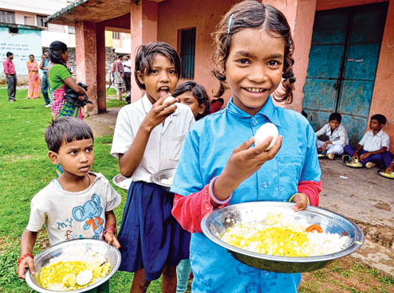
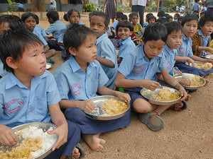
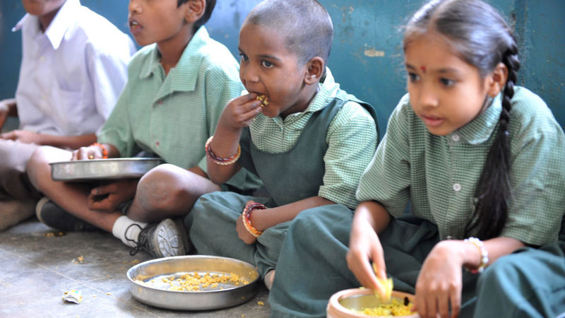
Thank you
Students of Hatma middle school in Ranchi savour their midday meal with eggs

